Slide 1

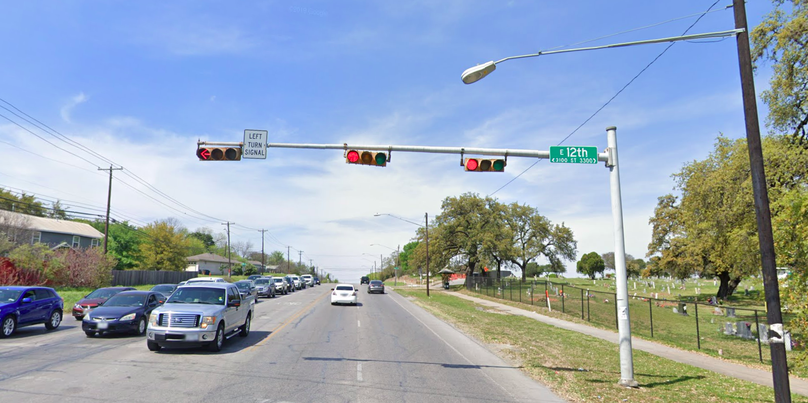
Austin Transportation Department Signs Work Orders
Created By: Susanne Gov Created Date: 2020-05-21 Location Name: AIRPORT BLVD / 12TH ST Intersection ID: 5162046 Cardinal Direction: N
Sign Type | Install/Remove
Street Name Sign | Install
Left Turn Signal | Install

Slide 2
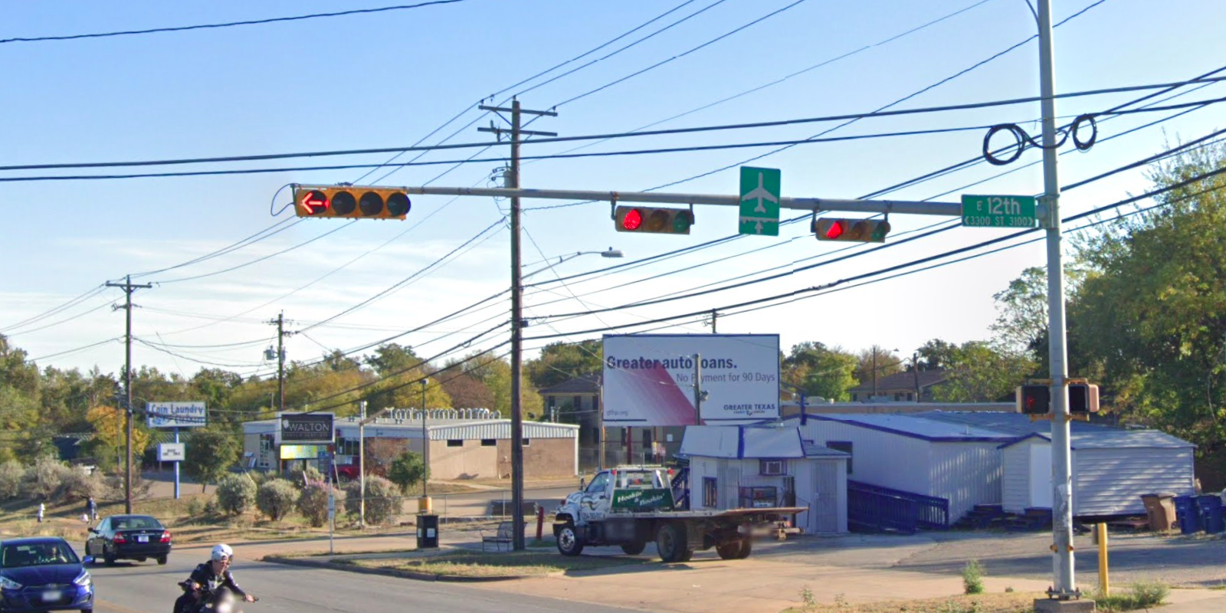
Austin Transportation Department Signs Work Orders
Created By: Susanne Gov Created Date: 2020-05-21 Location Name: AIRPORT BLVD / 12TH ST Intersection ID: 5162046 Cardinal Direction: S
Sign Type | Install/Remove
Street Name Sign | Install
Airport Symbol | Install

Slide 3
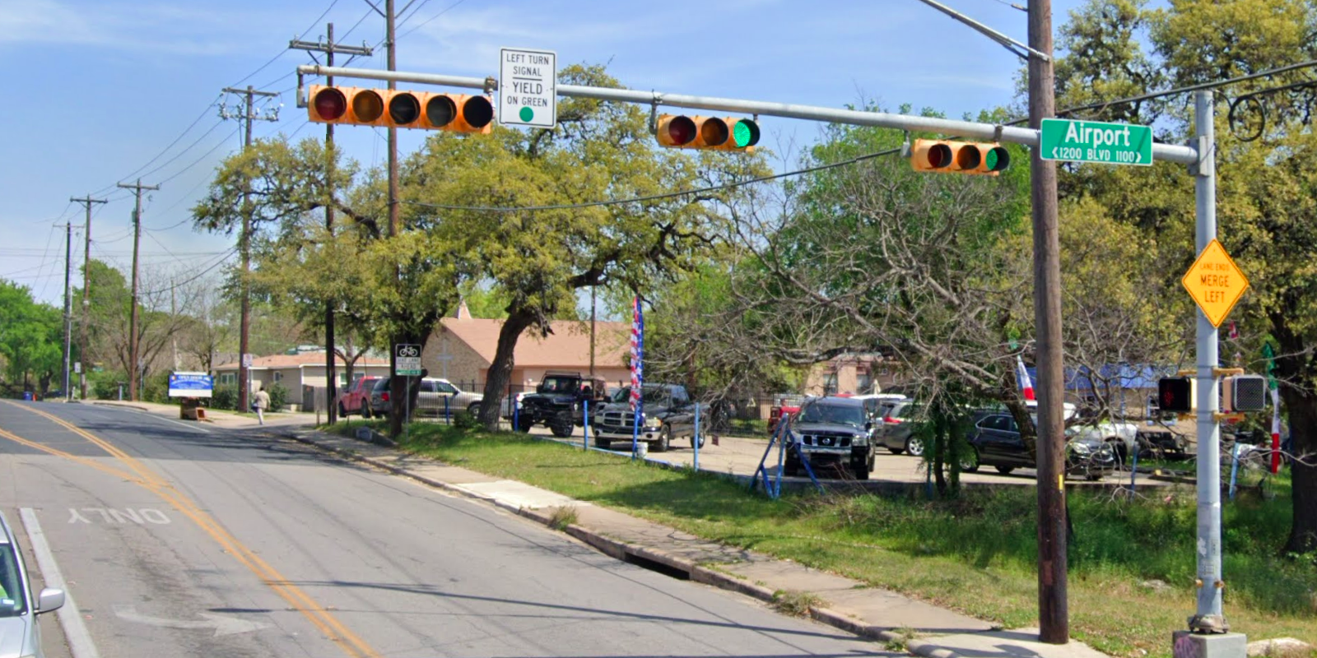
Austin Transportation Department Signs Work Orders
Created By: Susanne Gov Created Date: 2020-05-21 Location Name: AIRPORT BLVD / 12TH ST Intersection ID: 5162046 Cardinal Direction: E
Sign Type | Install/Remove
Left Turn Yield On Green | Install
Street Name Sign | Install
Lane Ends Merge Left | Install

Slide 4
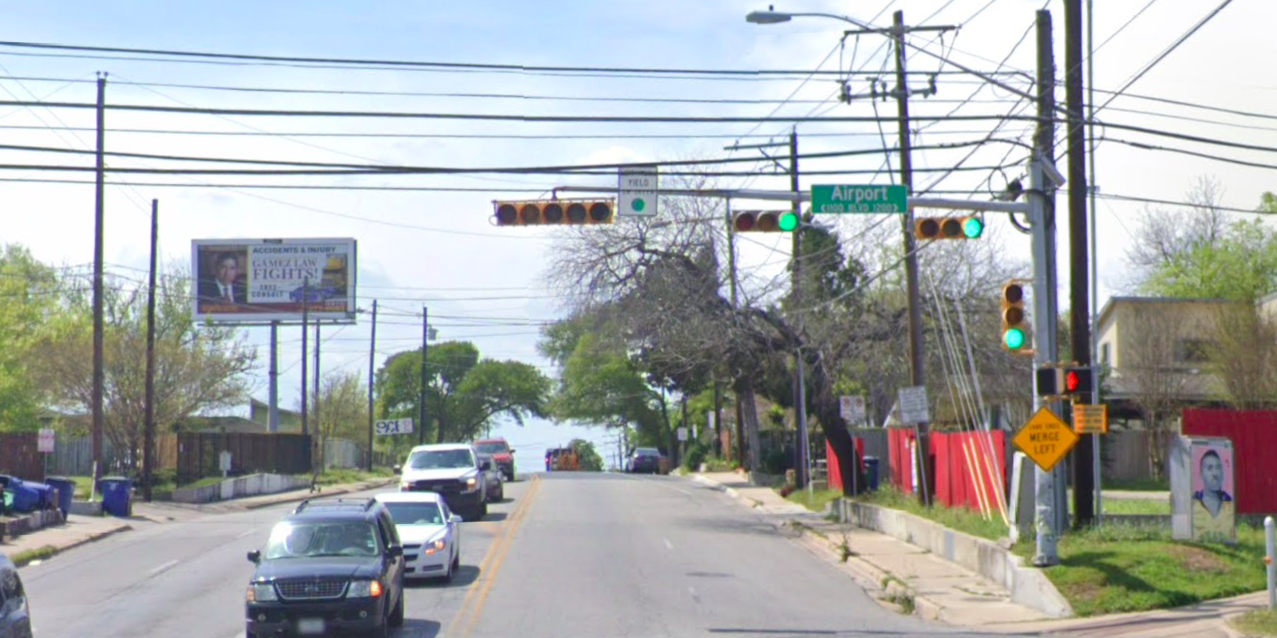
Austin Transportation Department Signs Work Orders
Created By: Susanne Gov Created Date: 2020-05-21 Location Name: AIRPORT BLVD / 12TH ST Intersection ID: 5162046 Cardinal Direction: W
Sign Type | Install/Remove
Left Turn Yield On Green | Install
Street Name Sign | Install

